Slide 1

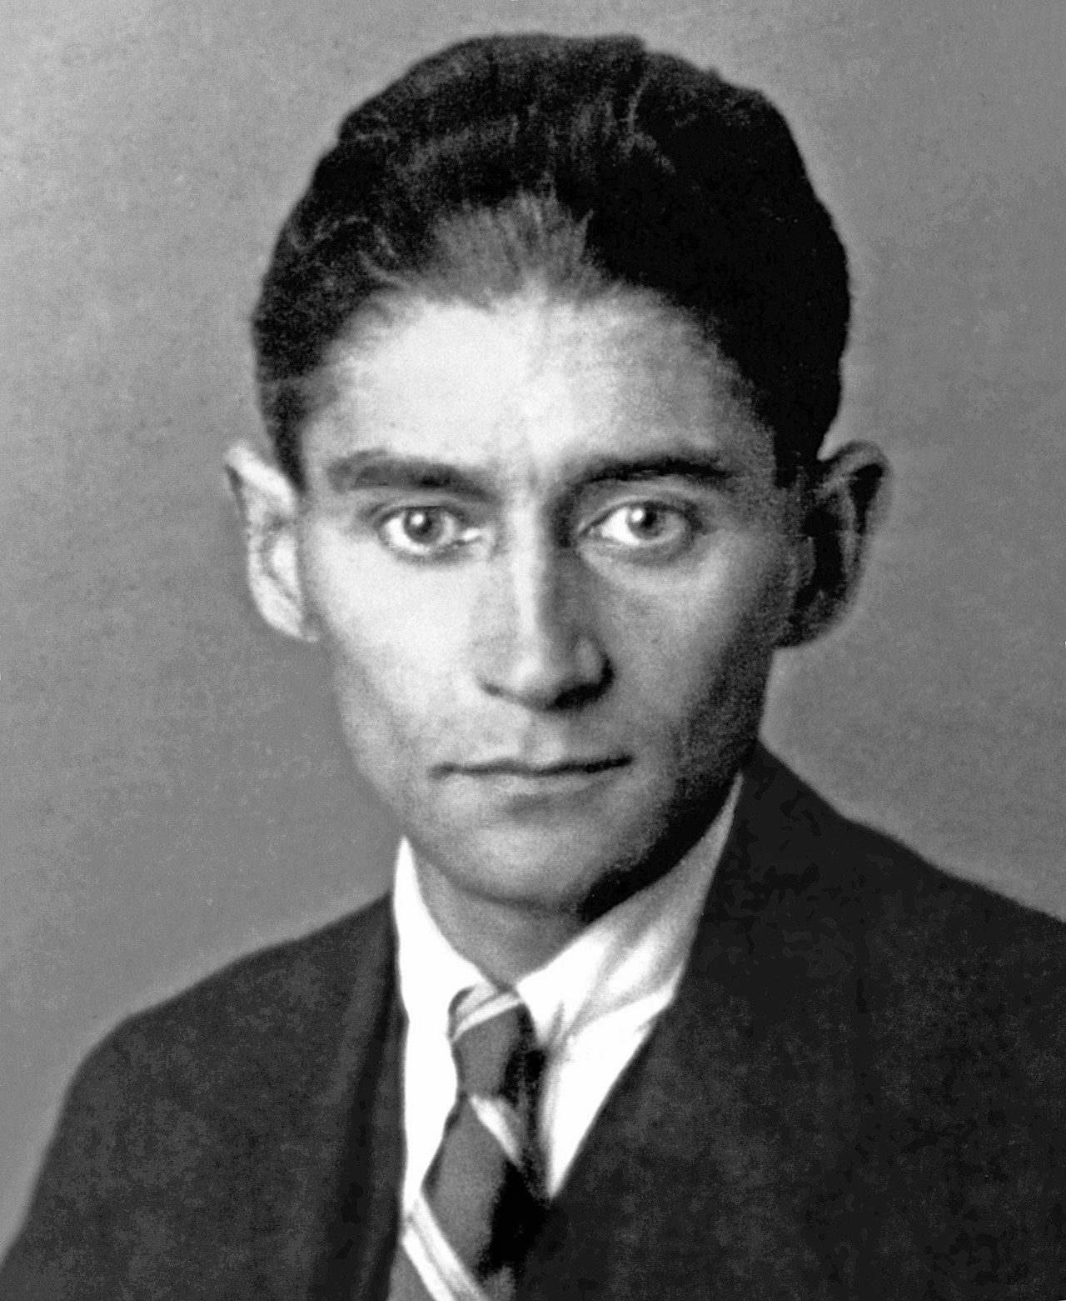
Kafka
Part 1

Slide 2
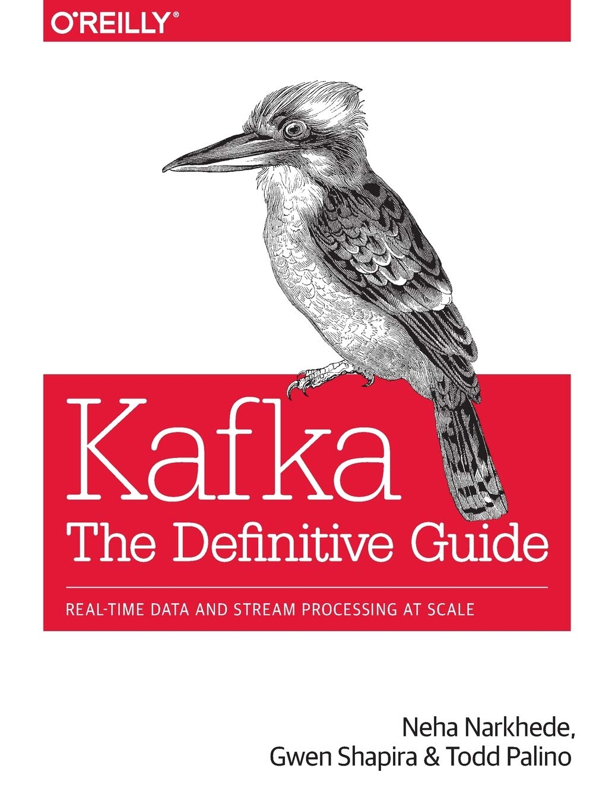

Resources

Slide 3
7 000 000 000 000 000 000 ⇔ 7 * 10^18

Slide 4
Kafka at LinkedIn - 2019
7 000 000 000 000 000 000 ⇔ 7 * 10^18
7 trillions messages handled / 24h
100 Kafka clusters
4 000 brokers
100 000 topics
7 000 000 partitions

Slide 5

Why Kafka - LinkedIn original use case
User activity tracking
Page views
Click tracking
Profile updates
Report generators
Machine learning systems
Search results updater
Topics

Slide 6
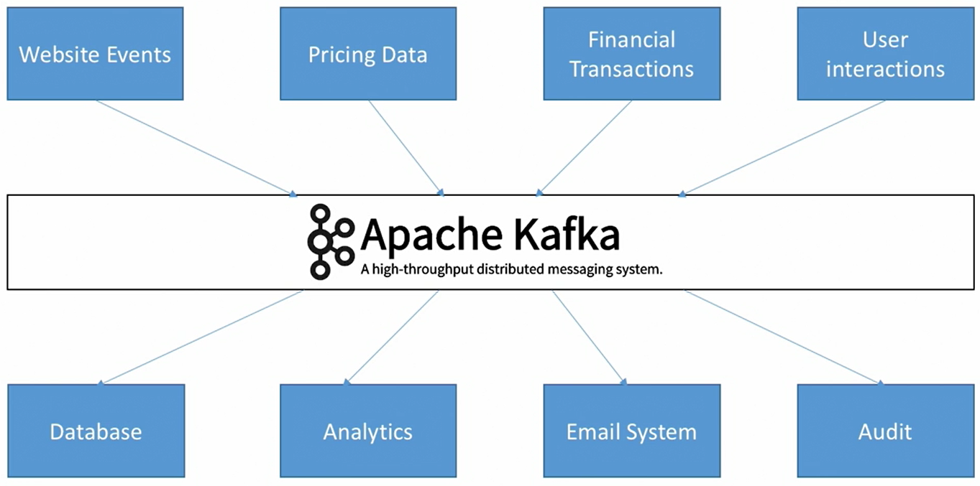
Why Kafka

Slide 7
Why Kafka - other use cases
Activity tracking
Messaging
Metrics and logging
Stream processing

Slide 8
Kafka and its benefits
Created at LinkedIn, now open source
Decouple data streams from services
Horizontal scalability - can scale to millions of messages per second
High performance - less than 10ms latency
Durable message retention

Slide 9
Vocabulary/concepts
Message
Topic
Partition
Broker
Replication factor
Producer
Consumer

Slide 10
Message
Unit of data - similar to a row or a record in a DB
An array of bytes - it has no meaning/format to Kafka
Can have an optional key - impact the writing strategy

Slide 11
Topic
A stream of data
Similar to a folder in a file system or a table in a DB
Identified by its name
Splits in partitions

Slide 12
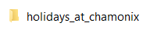

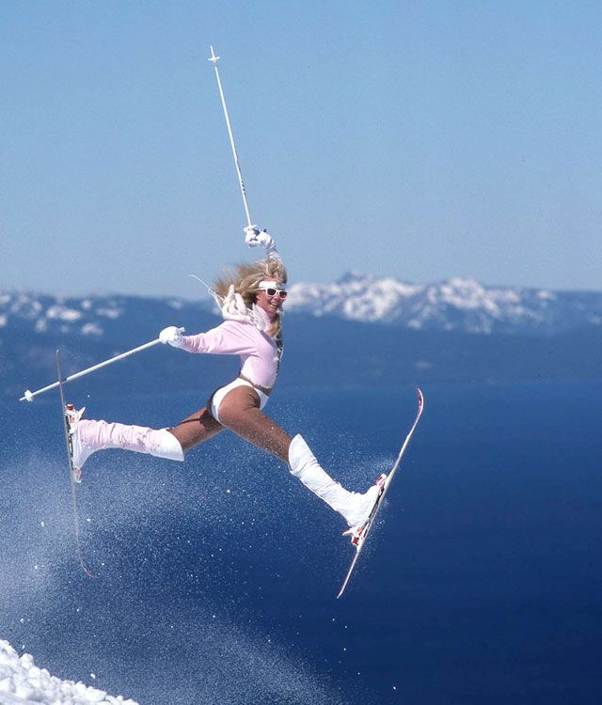
Topic example
Topic
Message
Message

Slide 13
Partition
Subset of data for a topic
Each message within a partition gets an incremental id called offset
Order is guaranteed only within a particular partition
Data written to a partition is immutable, can’t be changed
Data is assigned randomly to a partition unless a key is provided
Partitions are evenly distributed across brokers in a Kafka cluster

Slide 14
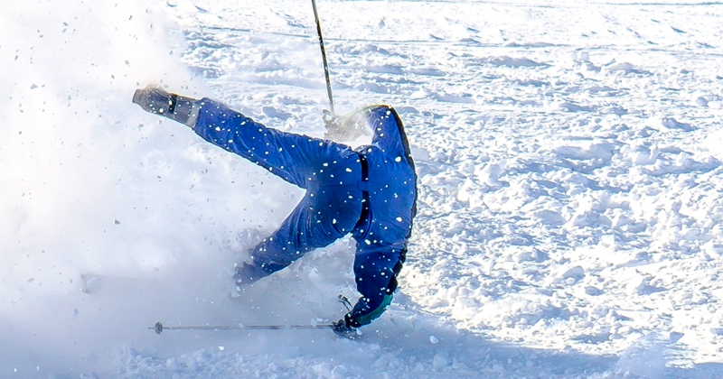
Partition example - subdfolders
Topic
holidays_at_chamonix:1
holidays_at_chamonix:2
Partition-1
Partition-2
Message
Message
Message
Message
Message

Slide 15
Broker
A Kafka server
Identified by an Integer
A Kafka cluster is composed of multiple brokers
Once connected to a broker, you are connected to the entire cluster
What happens to the associated partition(s) if a broker goes down?

Slide 16

Broker example
Personal laptop
Work laptop
holidays_at_chamonix:1
holidays_at_chamonix:2
holidays_at_chamonix:3

Slide 17
Replication factor
Number of copies of partitions for a topic
Duplicate data to avoid losing it if a broker goes down
A replication factor of 2 means that we would have 2 copies of data in different brokers

Slide 18
Replication factor example
Personal laptop
Work laptop
holidays_at_chamonix:1
holidays_at_chamonix:2 copy
holidays_at_chamonix:2
holidays_at_chamonix:1 copy

Slide 19
Producer
Write data to topic
A key can be sent along with the message
If the key is sent, all message with the same key will be written to the same partition - Allowing to maintain message ordering
If the key is not sent then data is written in partitions in a round robin manner

Slide 20

Producer example
holidays_at_chamonix:1
holidays_at_chamonix:2
Sends to topic
with key=”manol”
with key=”vlad”
with key=”manol”

Slide 21
Consumer
Consume data from topic
Data is read in order within each partitions
Consumers are part of a consumer group
Only 1 consumer within a consumer group can read data from a partition - If we have 3 consumers and 2 partitions then 1 consumer will be inactive

Slide 22
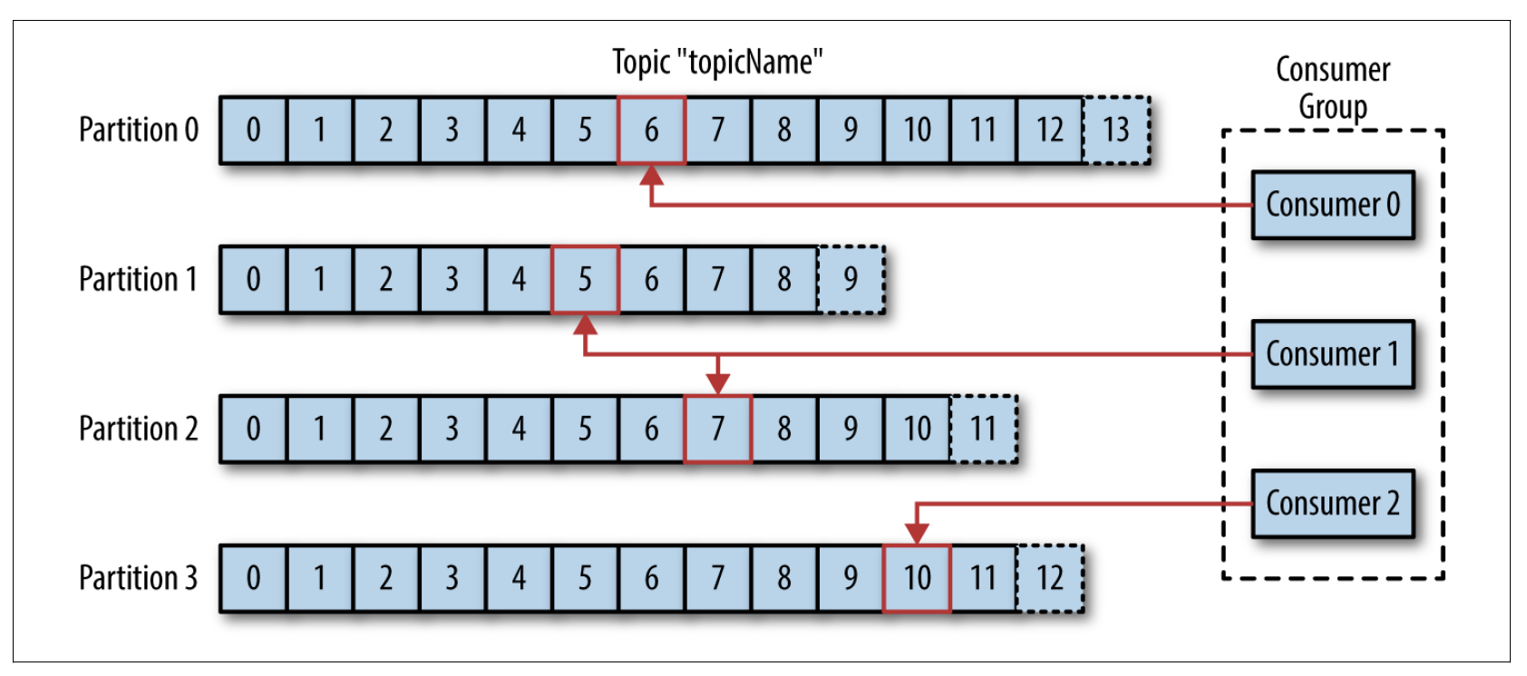
Consumer example

Slide 23
Demo

